Slide 1



Para Bank Web Application
Testing Project

Slide 2
Name: Ehab Khalil
Role: Student of 5-Tech QA Automation Developer Bootcamp.
Key Expertise: Python, Selenium WebDriver, Testing methodologies.
Professional Goals: Continuous learning and contributing to innovative software solutions.
Contact: ehabkalil5@gmail.com

Slide 3

Introduction to Para Bank Web Application
Para Bank is a simulated online banking system designed specifically for practice and educational purposes.
It mimics the functionalities of a real banking application with its realistic platform. The goal of this application is for users to practice and improve their skills in web application testing.

Slide 4
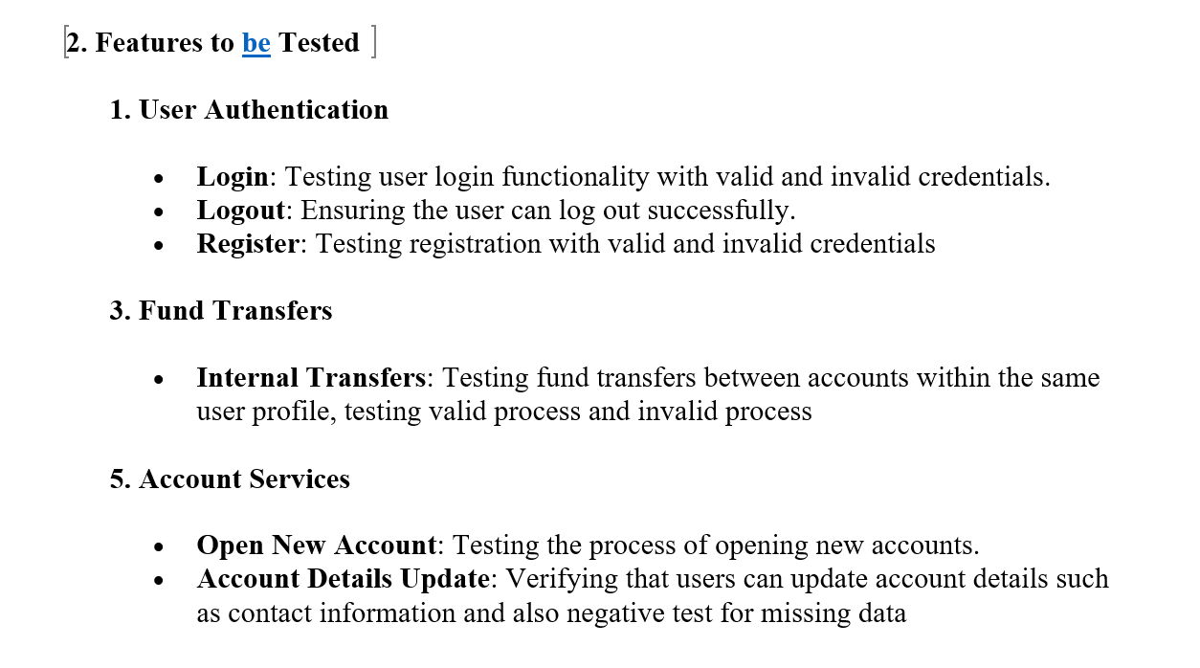

STP
This document ensures that all testing processes are well organized and effective, helping to identify and fix issues early to improve the quality of the software.

Slide 5
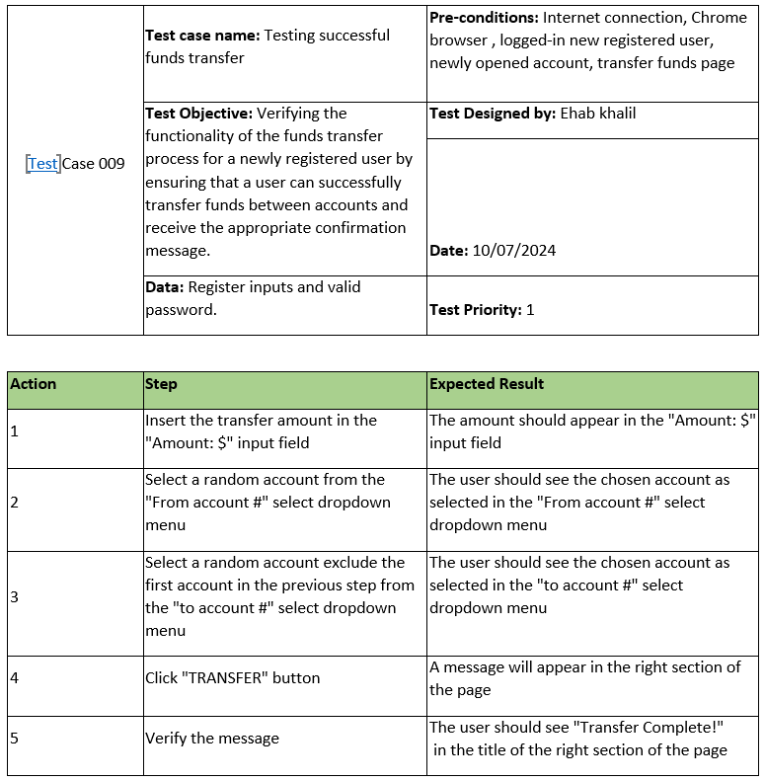
STD
The Software Test Design (STD) document outlines the detailed design of the test cases ensuring the software functions are correct and meets user expectations.

Slide 6
Examples of How Tests Ensure High Quality
Efficiency: Automated tests saves time and money running quickly and repeatedly
Consistency: Tests executed the same way every time reducing human errors
Resource Optimization: Less manual testing resource which results focusing on more creative and exploratory testing tasks
Coverage: They can cover a wide range of scenarios, including edge cases and complex interactions, ensuring thorough testing.

Slide 7


Slide 8
STP
STD
Bug Report
Requirements document

Slide 9
Summary
Our project emphasized the importance of the high detailed testing practice in ensuring that banking applications like ParaBank meet high standards of performance and security.
Additionally, automation played a crucial role in this process by increasing testing efficiency, reducing human error, and enabling continuous integration and delivery, ultimately enhancing the overall reliability and robustness of the application.
Thank you

